Slide 1

Carlos B. Banawan Jr.

Slide 2

CONTENT
Process Flow Diagrams
Change Approval Request
Vendor Record Update/Edit
Customizations and Data Designs
Change Policy
Change Approval Request
Approval Status (LIST)
Completion Status (LIST)
Scripts
Check for Change Approval Policy
Check Pre-Approved Change Request

Slide 3
PROCESS FLOW DIAGRAM
Change Approval Request Process
Vendor Record Update Process

Slide 4
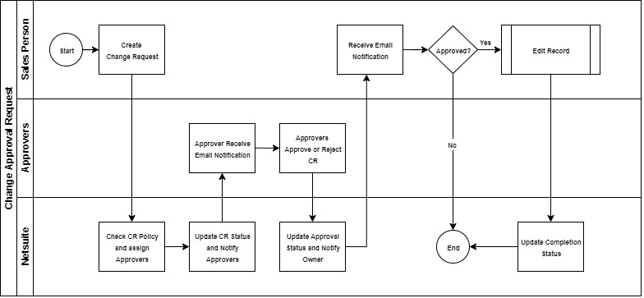
CHANGE APPROVAL REQUEST

Slide 5
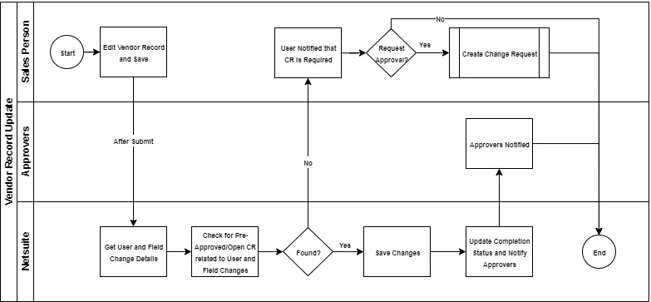
VENDOR RECORD UPDATE/EDIT

Slide 6
DATA CUSTOMIZATIONS
Change Approval Policy
Change Approval Request
Approval Status (LIST)
Complete Status (LIST)
Change Approval Type (LIST)

Slide 7
CHANGE APPROVAL POLICY
CUSTOM RECORD TYPE
Name: Change Approval Policy
ID: customrecord_change_approval_policy
Fields:
Name | ID | Type | List/Record
Finance Approvers | custrecord_finance_approver | Multiple Select | Employee
Sales Manager Approvers | custrecord_sales_managers_approvers | Multiple Select | Employee
Default Policy | custrecord_is_default_policy | Check Box

Slide 8
CHANGE APPROVAL REQUEST
CUSTOM RECORD TYPE
Name: Change Approval Request
ID: customrecord_change_approval_request
Fields:
Name | ID | Type | List/Record
Change Type | custrecord_cr_change_type | List/Record | Change Approval Type
Affected Employee | custrecord_cr_affected_employee | List/Record | Employee
Description | custrecord_cr_description | Free-Form Text
Mandated Approvers | custrecord_cr_mandated_approvers | Multiple Select | Employee
Approval Status | custrecord_cr_approval_status | List/Record | Approval Status
Approval Notes | custrecord_cr_approval_notes | Free-Form Text
Completion Status | custrecord_cr_completion_status | List/Record | Completion Status
Approved By | custrecord_cr_approved_by | Multiple Select | Employee
Approved Date | custrecord_cr_approved_date | Date/Time

Slide 9
Approval Status
CUSTOM LIST TYPE
Name: Approval Status
ID: customlist_change_approval_status
Name | Internal ID
Not Started | 1
Pending Approval | 2
Approved | 3
Rejected | 4

Slide 10
Completion Status
CUSTOM LIST TYPE
Name: Completion Status
ID: customlist_completion_status
Name | Internal ID
Open | 1
Completed | 2
Cancelled | 3

Slide 11
Change Approval Type
CUSTOM LIST TYPE
Name: Change Approval type
ID: customlist_change_approval_type
Name | Internal ID
Vendor | 1
Customer | 2

Slide 12
SCRIPTS
Check for Change Approval Policy
Check Pre-Approved Change Request

Slide 13
Change for Change Approval Policy
TYPE: User Event
NAME: Check for Change Approval Policy
ID: customscript_check_cr_approval_policy
API VERSION: 2.0
SCRIPT FILE: CheckChangeApprovalPolicy.js
DESCRIPTION:
The script checks the default Approval Policy record and fetch the assigned
Approvers from it.

Slide 14
Check Pre-Approved Change Request
TYPE: User Event
NAME: Check Pre-Approved Change Request
ID: customscript_check_pre_approved_cr_cs
API VERSION: 2.0
SCRIPT FILE: CheckPreApprovedChangeApprovalCS.js
DESCRIPTION:
The script controls the editing of the record, allowing edits only when an
existing Approved, and not Completed Change Approval Request is found for
the current User.

Slide 15
END
Thank you!

